Slide 1



SMART CONTRACT
Powered by Blockchain technology
Subir Ghosh
Amitabh Cheekoth
Balasubramanya Ramaswamy
Vinod Thottupurath
15 April 2018

Slide 2


Agenda
TBD

Slide 3

Overview
Background:
Huge amount of manual work is involved in contract management lifecycle. Our objective is to develop a futuristic solution for contracts, digitised and efficient.
Current State
Proposed Solution
Expected Results:
Manual process
Paper based contracts
Multiple versions/ emails
Tedious and laborious
Digitized and automated process
Single repository and enhanced collaboration
Reduced effort and efficient
Automated Smart Contract
Powered by Blockchain

Slide 4
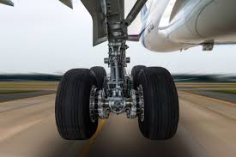
Example considered
Etihad establishes approximately 5000 contracts every year, with various Service Providers.
Etihad engage OEMs/ MROs for maintenance and overhaul of aircraft components. A scenario of Landing gear overhaul contract is considered here as an example
‘Enabling Etihad to establish and manage contracts with OEMs and third party maintenance units for aircraft landing gears, leveraging the potential of Blockchain and Smart Contracts ’
Etihad currently have 48 types of landing gears that are managed through contacts for overhaul.

Slide 5


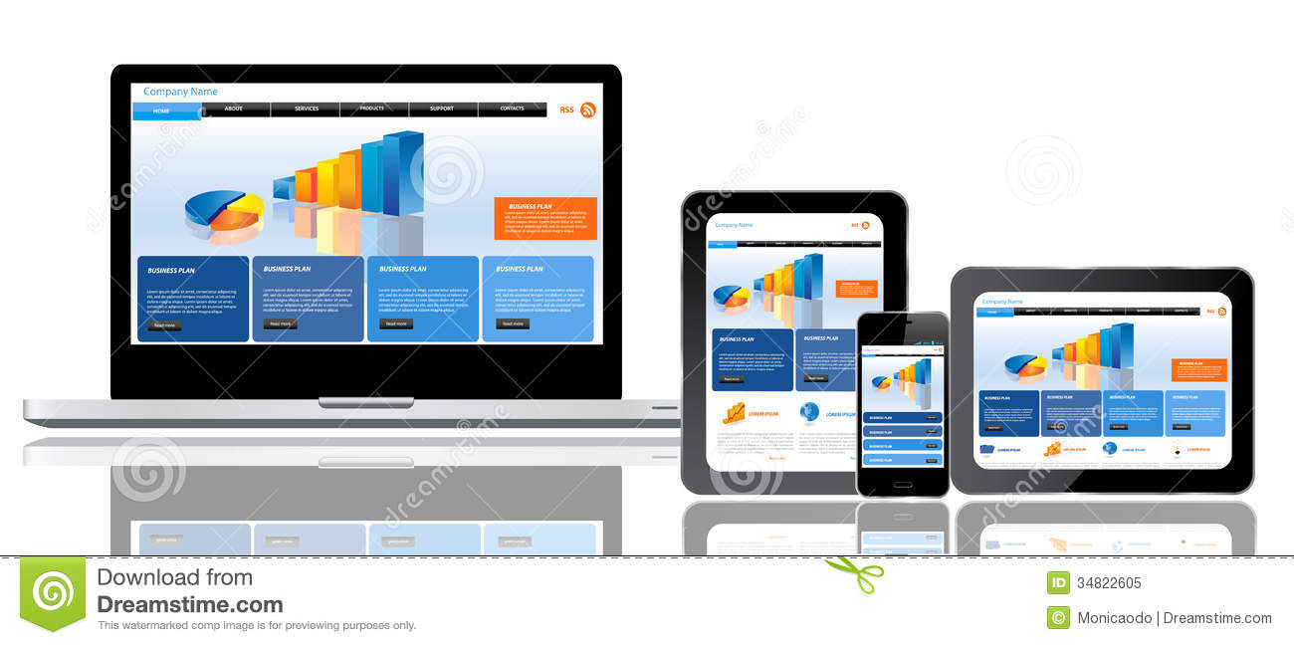
Smart Contracts
Smart contract enables collaborative processing, on shared and distributed network.
EY Lawyer
Vendor
Finance
EY Lawyer
Vendor
Rep
Vendor
Rep
EY Contracts
Manager
EY Contracts
Manager
Vendor
Finance
Vendor
Lawyer
EY Finance
Vendor
Lawyer
EY Finance
Manual and time consuming process
Email exchanges and multiple versions
Paper based contract management
Multiple copies of physical paper versions managed
Dispute resolution requires back office
True digitized through business rules enablement
Single source of truth
Efficiency and collaboration
Increased transparency and auditability
Highly reliable and secure

Slide 6



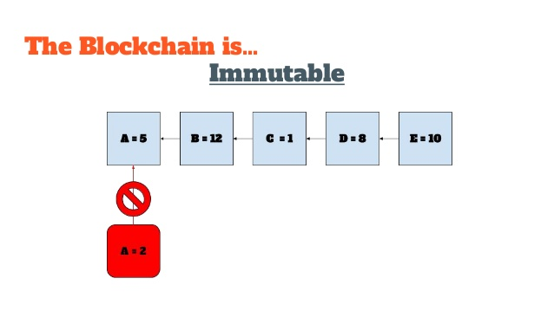


Business Benefits
Business can add value through smart contracts and by adopting blockchain technology.
True Digitisation:
Contracts are in a digital ledger, with logics and attributes.
Trust:
Built on a shared and distributed network, transparent transactions.
Efficiency
Enables collaboration and eliminates intermediaries
Immutable.
Distributed registry, cannot be lost
Security:
Stored in a decentralized registry
Precision in execution:
Reducing errors, risks
Less chances of disputes or litigation

Slide 7
Consortium participation in the Blockchain
A320 Maintenance
A380 Maintenance
A320 LG Contract
A380 LG Contract
(Re-engineering the process)
BENEFITS
Contract digitization (completely paperless)
Contracts cannot be tampered
Trust (uncertainties & disputes removed)
Self auditing (self governing)
Intermediaries not needed
Unified ledger distributed across consortium members

Slide 8
Adoption and suggested next steps
Implementation effectiveness is considered. Feasible and relevant contracts will be identified for Pilot project. Lessons learned will be incorporated in corporate-wide roll out.
Next Steps
Pilot with easily implementable contracts (quick-wins), with identified vendors
Extend for corporate-wide contract management

Slide 9
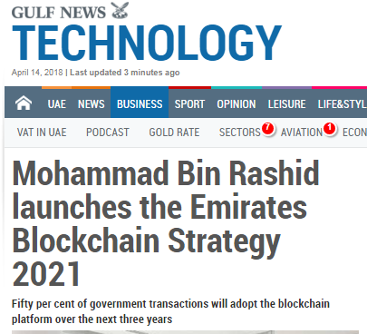
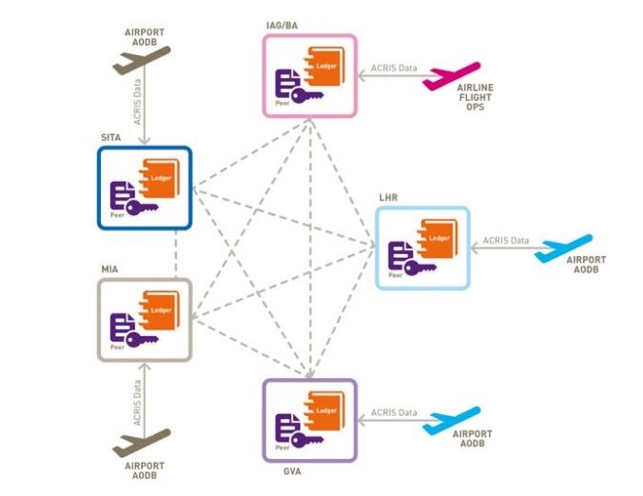
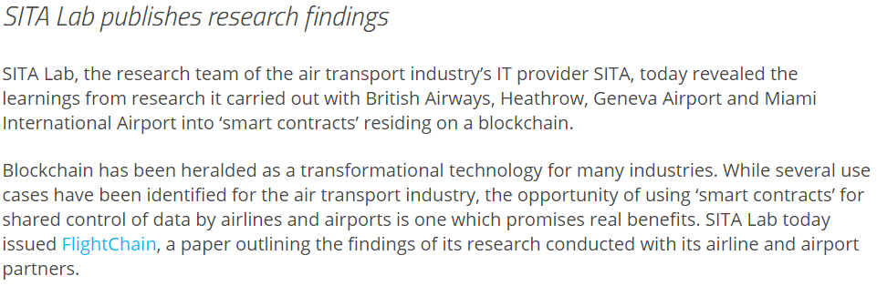
Other areas of application in Etihad
“ 50 per cent of government transactions will adopt the blockchain platform over the next three years…It is expected to save 398 million printed documents and 77 million work hours annually.”
Etihad can pioneer future technology in alignment with UAE Government‘s strategy
Source: Gulf News
Identity Management: Traveler Identity is managed for seamless experience for Etihad’s guest
Financial: Loyalty points as Blockchain powered currency for earning and burning
Traceable record maintenance: Manage a virtual authentic copy of the operation and maintenance logs of every parts.
Source: SITA

Slide 10
Additional Slides

Slide 11



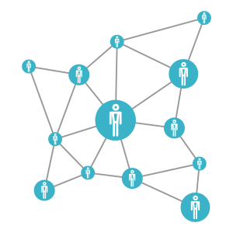








Technology stack used
REST
JSON-RPC & REST
Browser/ UI
Public Ethereum Blockchain (Rinkeby Test Network)
App Server
Ethereum Smart Contract dev & testing
SCM, Collaborated development
Local ethereum network (blockchain)
Local/ Cloud Server

Slide 12
Demo Link
https://www.useloom.com/share/021b06810ff242b6b7e6f00185928693
* Viewable outside Etihad network
https://web.microsoftstream.com/video/2aeac23c-49c6-42cd-b7a8-49ddd96b332d
* Accessible via Office 365

